Slide 1
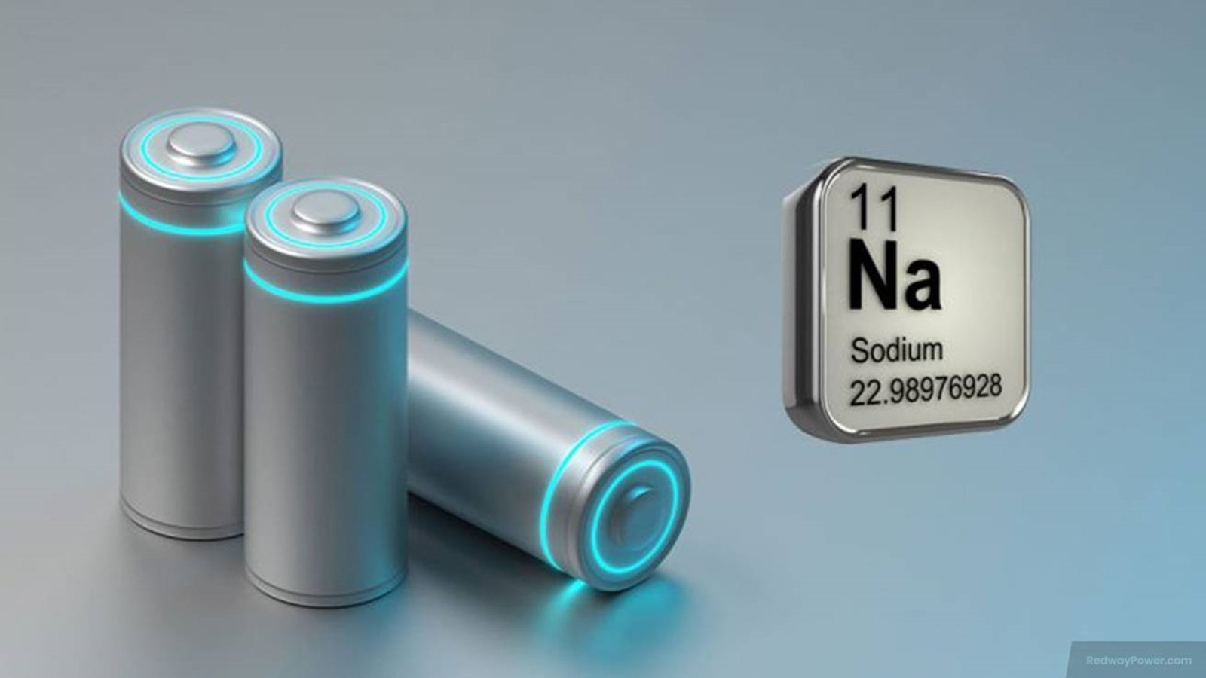
STRUCTURAL, MORPHOLOGICAL, AND ELECTROCHEMICAL STUDIES OF Mg DOPED SODIUM VANADIUM PHOSPHATE (Mg-NVP) CATHODE MATERIALS FOR SIBs
Abdussalam Usmani

Slide 2
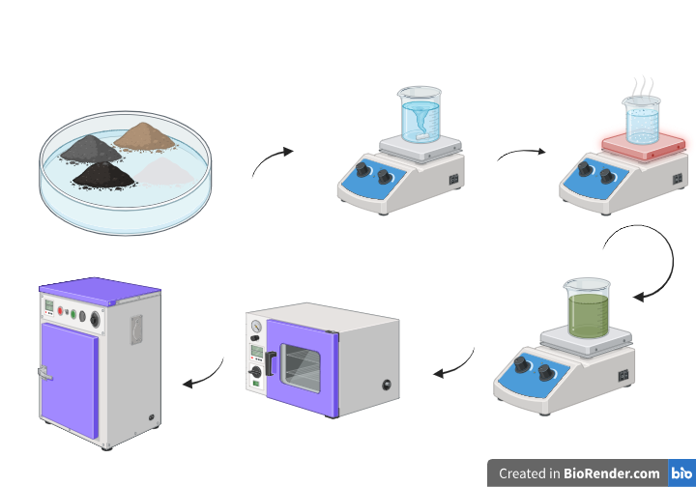
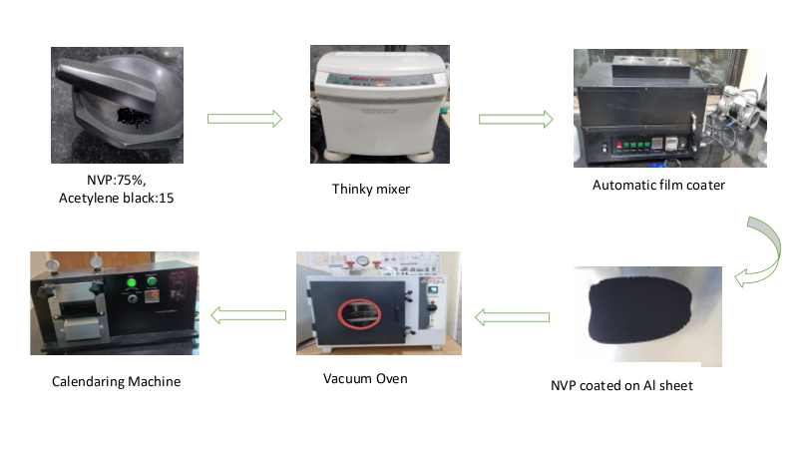
Synthesis & Fabrication of Mg-NVP Cathode for SIB
Fig 1 : Synthesis and Fabrication of Mg-NVP cathode

Slide 3
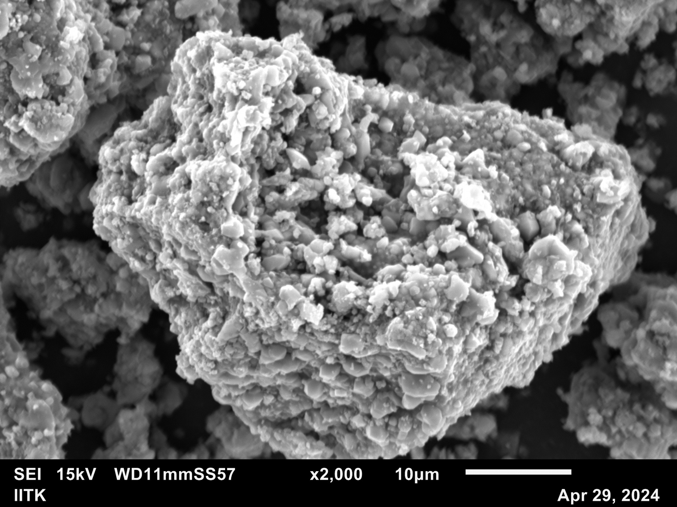
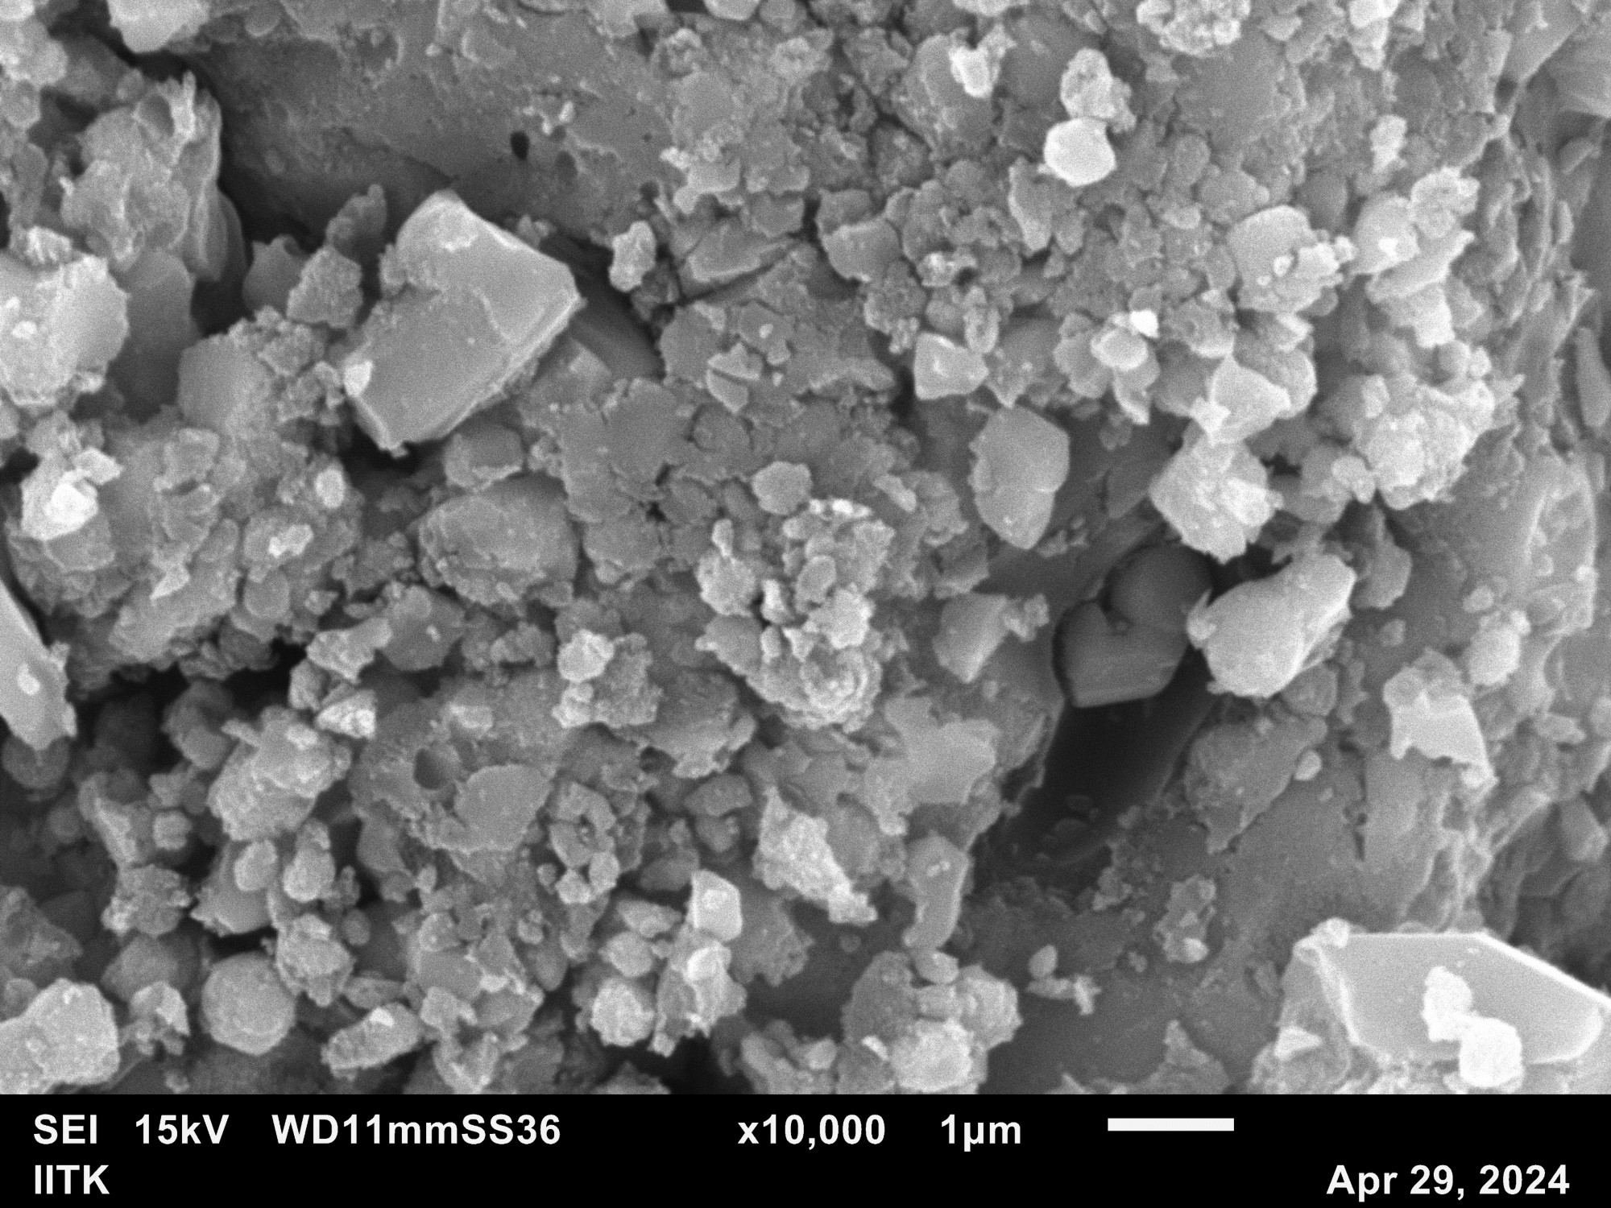
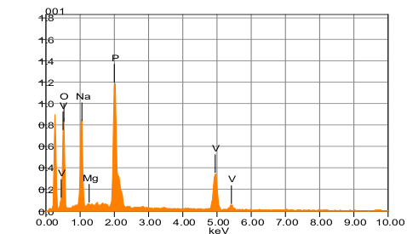
X-RD, SEM & EDS analysis of Mg-NVP
Chemical formula mass% Atom% Sigma Net K ratio Line
O 38.20 56.30 0.21 19400 0.0236928 K
Na 14.97 15.36 0.13 25846 0.0202160 K
Mg* 0.40 0.39 0.05 757 0.0004791 K
P 21.67 16.50 0.15 45743 0.0399873 K
V 24.75 11.46 0.23 20839 0.0486915 K
Total 100.00 100.00
Fig 2 : X-RD, SEM and EDS analysis of Cathode powder

Slide 4
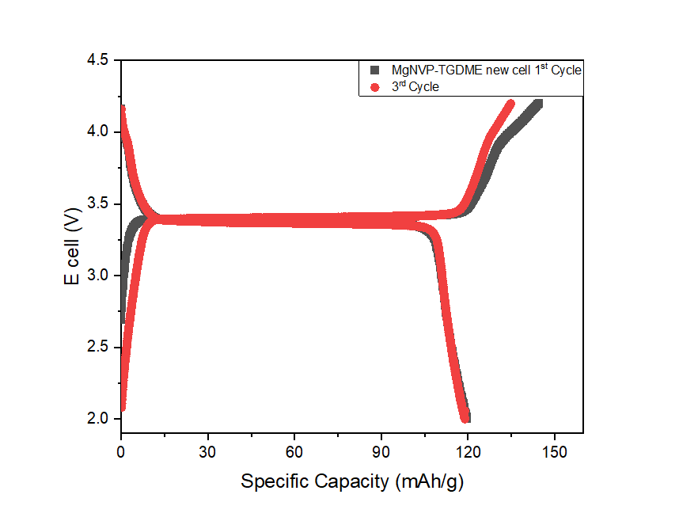
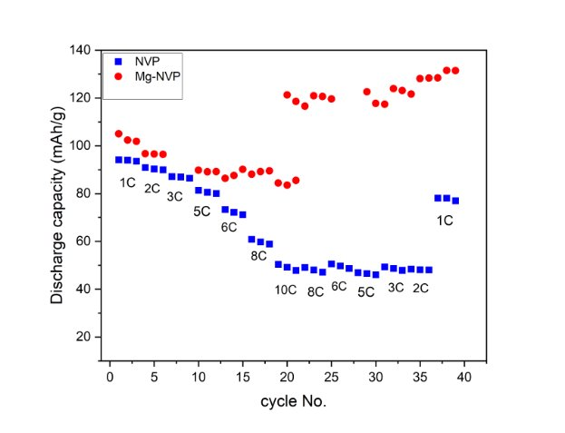
Electrochemical analysis of the cell

Slide 5
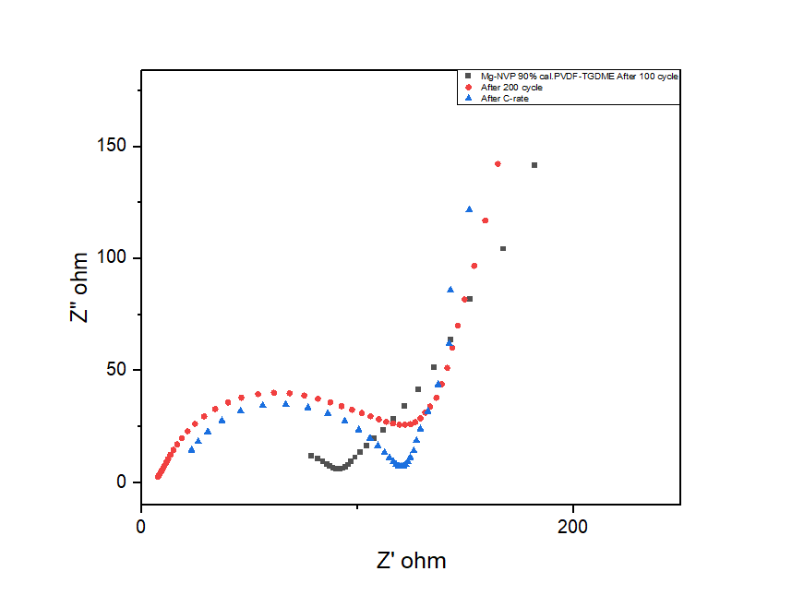
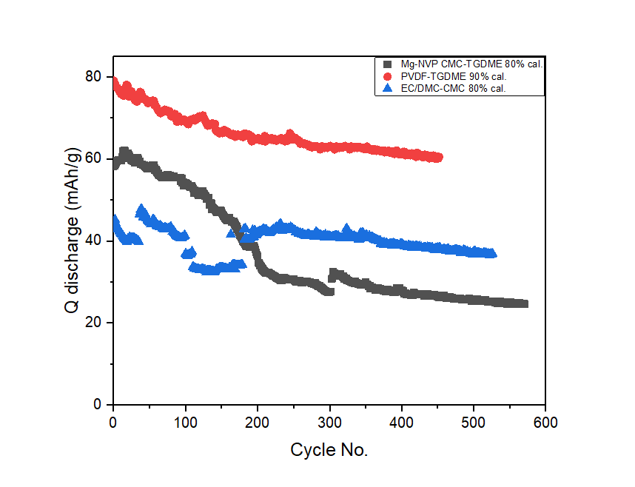
Fig 3 : Electrochemical analysis of the Cell

Slide 6
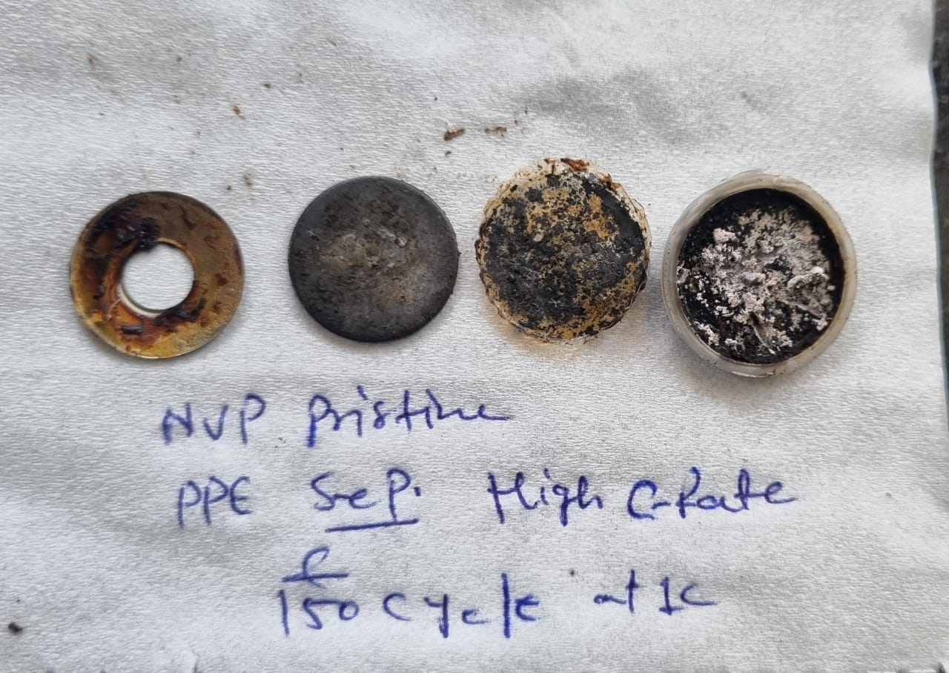
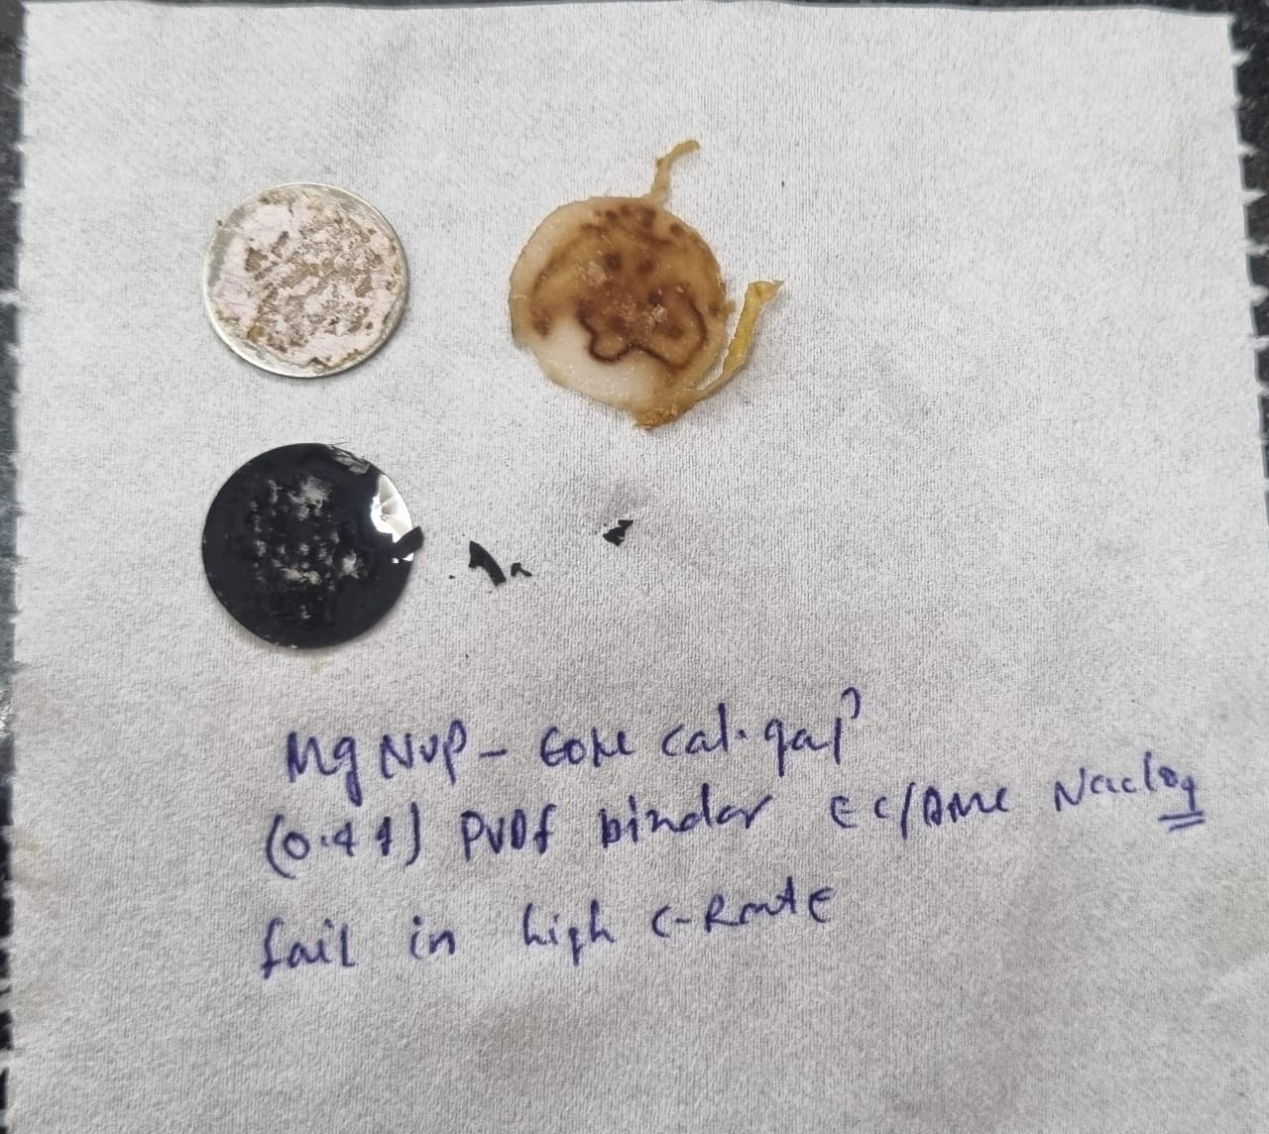
De-crimping of Sodium half cell
Fig 4 : Postmortem analysis of Cell

Slide 7


